Slide 1

Predicting customer churn in teleccomunations
Group 3
Oguz Bokzkurt, Gehad Mohamed, Gabriel Titeux,
Abdalrhman Dabor, Jonathan Bergkvist

Slide 2
Application Domain
Telecommunications Industry
  Telecom companies face strong competition
  Customers can easily switch providers
  Losing customers leads to revenue loss and acquisition costs
Goal:
  Use predictive analytics to identify customers at risk of churn.

Slide 3
Business Problem
Telecommunications Industry
  Customer churn reduces long-term revenue
  Retaining customers is often cheaper than acquiring new ones
  Early identification of churn risk enables proactive retention strategies
Objective:
  Develop a predictive model to identify customers likely to churn.

Slide 4
Potential Analytical Solutions
Two Possible Solutions
Solution 1: Churn Prediction Model
    Predict if a customer will churn
Solution 2: Churn Timing Model
    Predict when customers are likely to churn

Slide 5
Solution Comparison and Selection
Selected solution
  Churn prediction model due to higher data availability and simpler implementation
Criteria | Churn Prediction | Churn Timing
Data availability | High | Moderate
Complexity | Lower | Higher
Business implementation | Easy | More complex

Slide 6
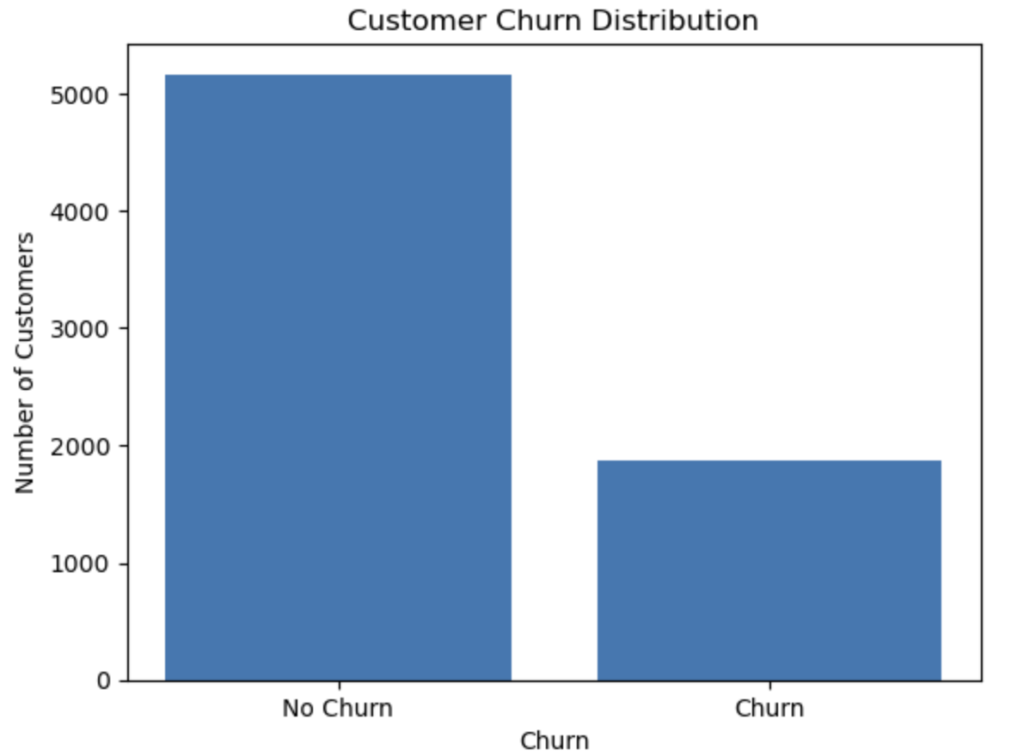
Dataset Description
Dataset Characteristics
  7,043 customers
  21 variables
  7,032 records after cleaning
  Target variable: Churn

Slide 7
Data Preparation
Data preparation steps
  Converted TotalCharges to numeric
  Removed invalid rows
  Removed customerID
  One-hot encoding for categorical features
  Standardized numerical features
  Train/test split (80/20)

Slide 8
Predictive Models
Model 1: Logistic Regression
  L2 regularization
  C = 1.0
  max_iter = 1000
Model 2: Gradient Boosted Decision Trees
  n_estimators = 200
  learning_rate = 0.05
  max_depth = 3

Slide 9
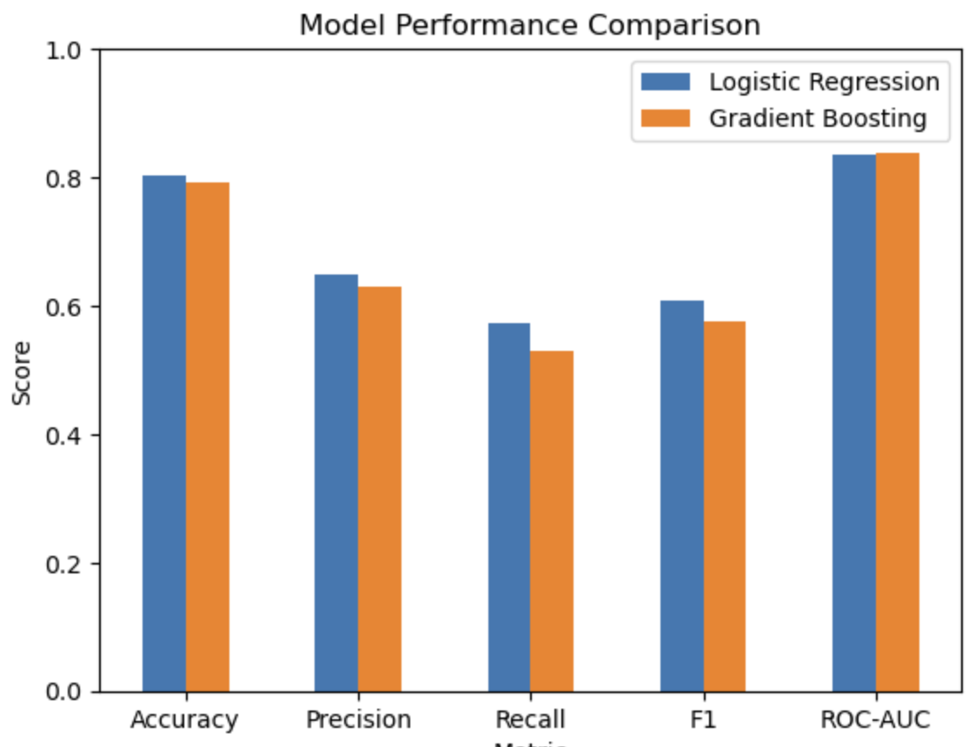
Model Evaluation
Evaluation metrics:
  Accuracy
  Precision
  Recall
  F1-score
  ROC-AUC
Metric | Logistic | Gradient Boosting
Accuracy | 0.804 | 0.792
Recall | 0.572 | 0.529
F1-score | 0.608 | 0.576
ROC-AUC | 0.836 | 0.839

Slide 10
Key Drivers of Customer Churn
Feature | Impact on Churn | Interpretation
tenure | Strong negative | Customers who stay longer are less likely to churn
Contract_Two year | Negative | Long-term contracts increase customer retention
Contract_Month-to-month | Positive | Flexible contracts increase churn risk
MonthlyCharges | Negative relationship | Higher monthly costs influence churn behaviour
InternetService_Fiber optic | Positive | Fiber users may churn more due to price or competition
TotalCharges | Positive | Reflects longer service usage but also billing effects

Slide 11
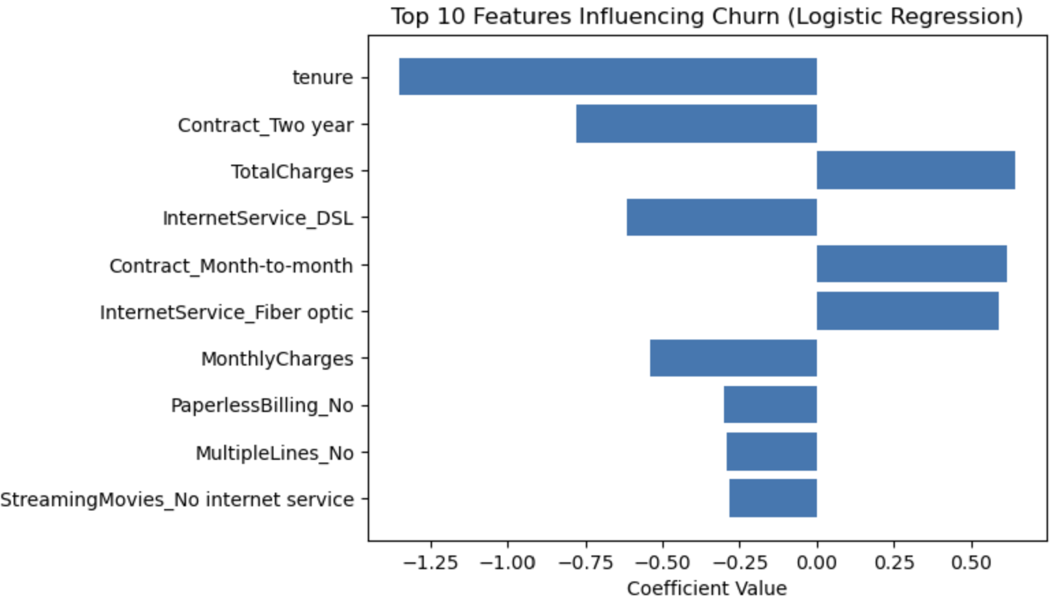
Key Drivers of Customer Churn (cont.)
Key Factors Influencing Customer Churn (Logistic Regression)
  Month-to-month contracts show the highest churn risk
  Long tenure and two-year contracts increase loyalty
  Higher monthly charges and fiber internet are linked to higher churn
  Promoting long-term contracts could help reduce churn

Slide 12
Discussion
Key Insights
  Churn can be predicted with reasonable accuracy using customer data
  Logistic Regression performed competitively with a more complex model
  Model interpretability supports business decision-making
Key Insights
  Include additional behavioral features
  Incorporate retention campaign data
  Apply uplift modeling for targeted retention strategies

Slide 13
Distribution of Work
Distribution of work among group members
  Jonathan Bergkvist
  Oguz Bozkurt
  Abdalrhman Dabor
  Gehad Mohamed
  Gabriel Titeux

